Slide 1
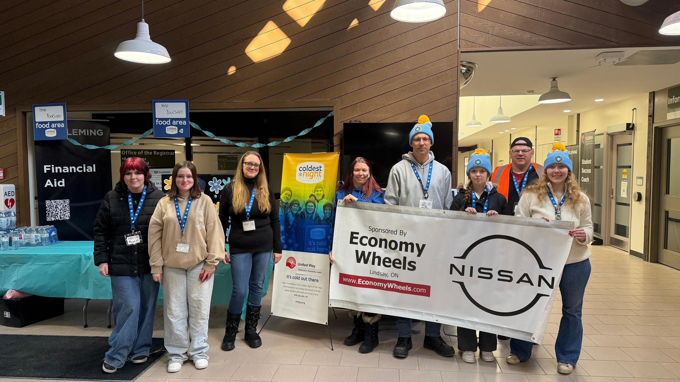
UNITED WAY HALIBURTON KAWARTHA LAKES
2026-2027 CAMPAIGN
Raising Hope, Growing Community

Slide 2
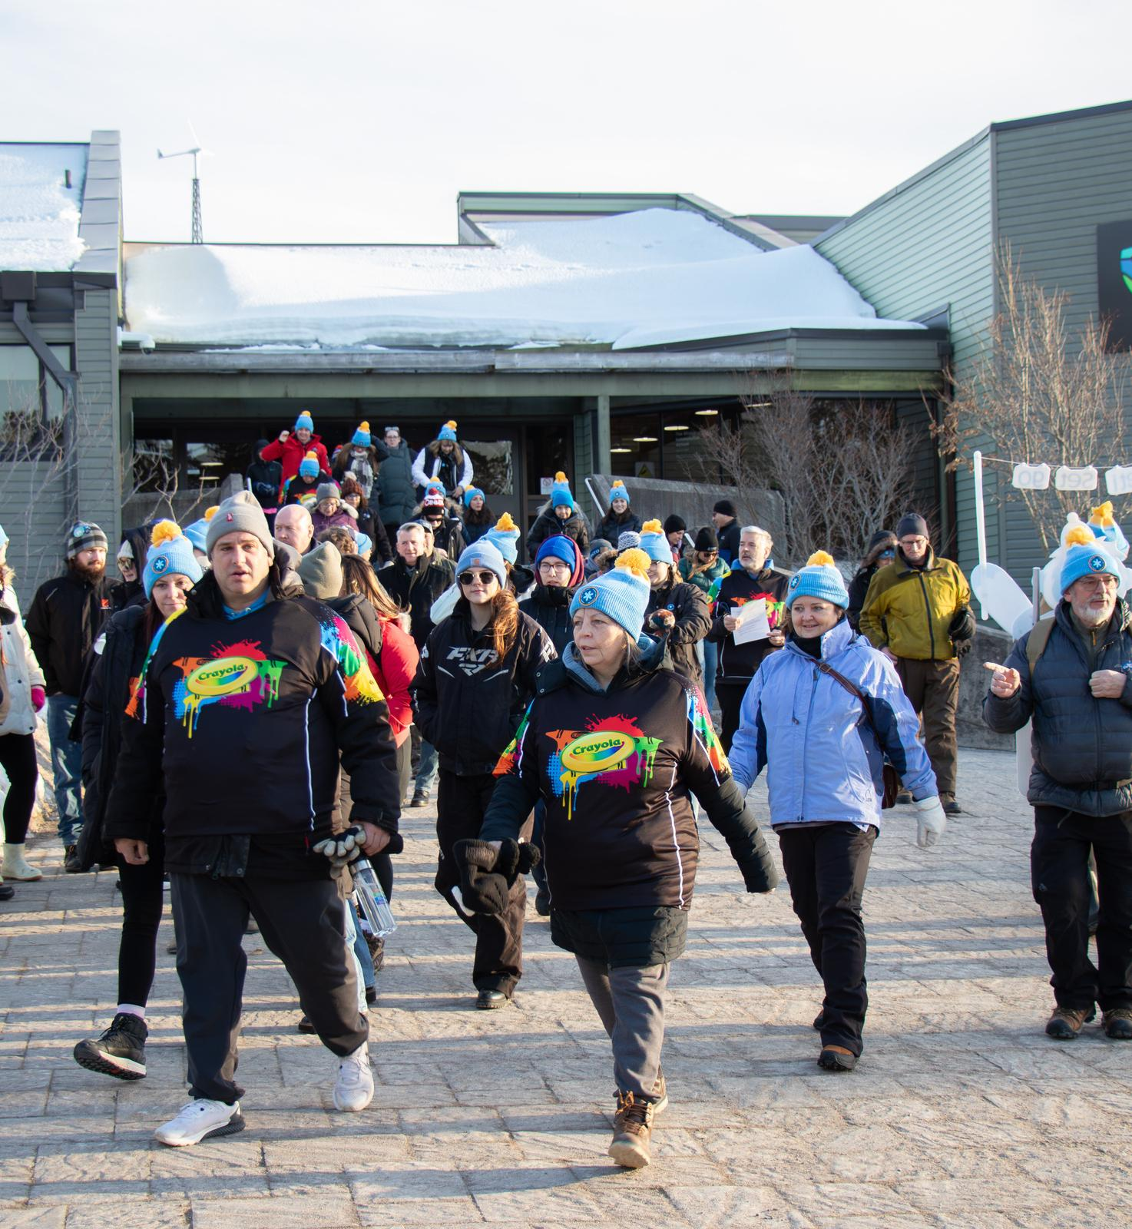
Your United Way
United Way for Haliburton Kawartha Lakes supports agencies and programming in the City of Kawartha Lakes and Haliburton County. All funds raised stay local. Therefore, funds raised in Kawartha Lakes stay in CKL and funds raised in Haliburton County stay in Haliburton County.
None of this is possible without the support of our valued donors. UWHKL needs your support more than ever as we continue to work with our partners to help the community grow and build towards a stronger future. The following pages provide more information about our work, what will be needed going forward and how you can help.

Slide 3

What does United Way HKL do?
United Ways across Canada bring people and organizations together to meet community needs and tackle complex social issues.

Slide 4
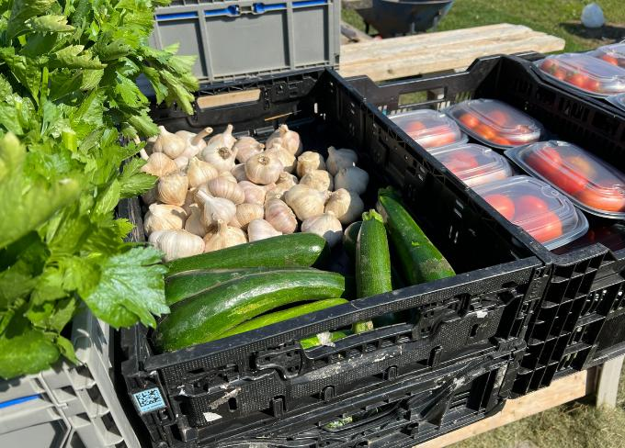
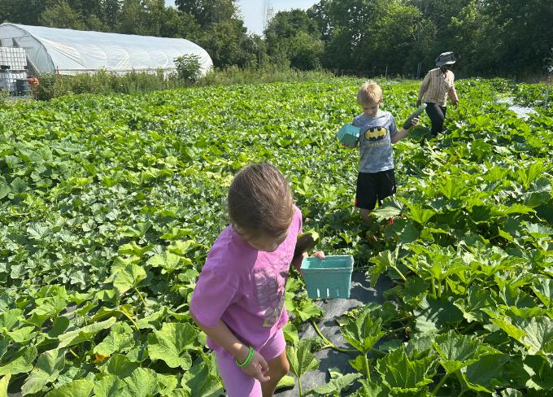
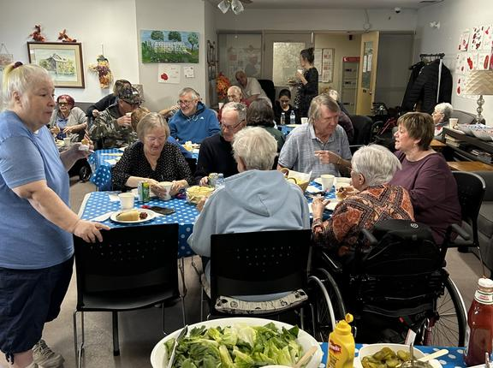
The Three Pillars
United Way’s work focuses on three key strategies that create opportunities for everyone in our communities to live a better life.
From Poverty to Possibility:
All That Kids Can Be
Healthy People, Strong Communities
Giving children and youth the support they need to get a great start in life, do well in school, and reach their full potential.
Helping to meet the basic needs of our community’s most vulnerable people, giving every Canadian the opportunity to realize a better future.
Creating vibrant neighbourhoods, where everyone experiences a sense of belonging and connection to one another.

Slide 5
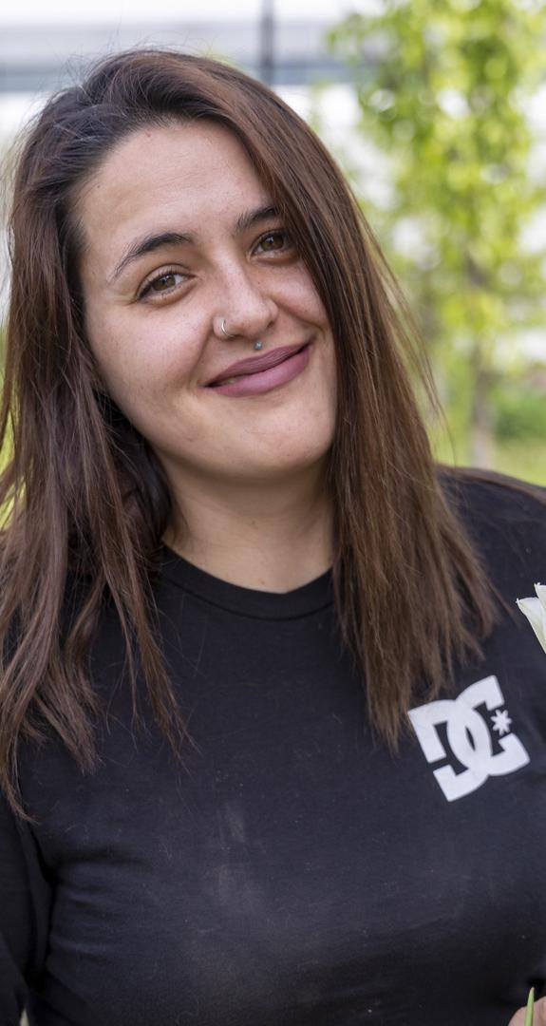
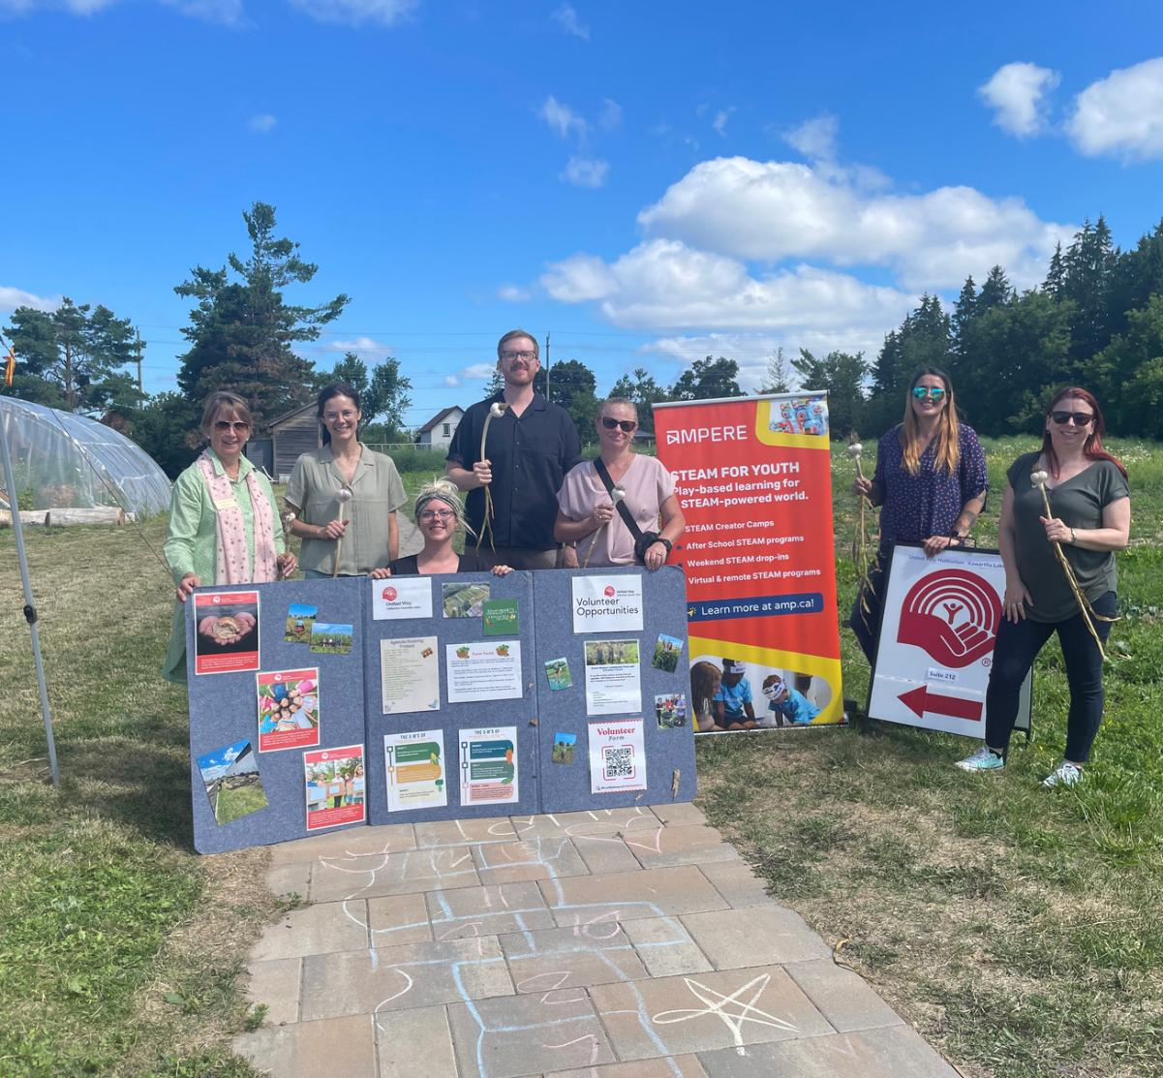

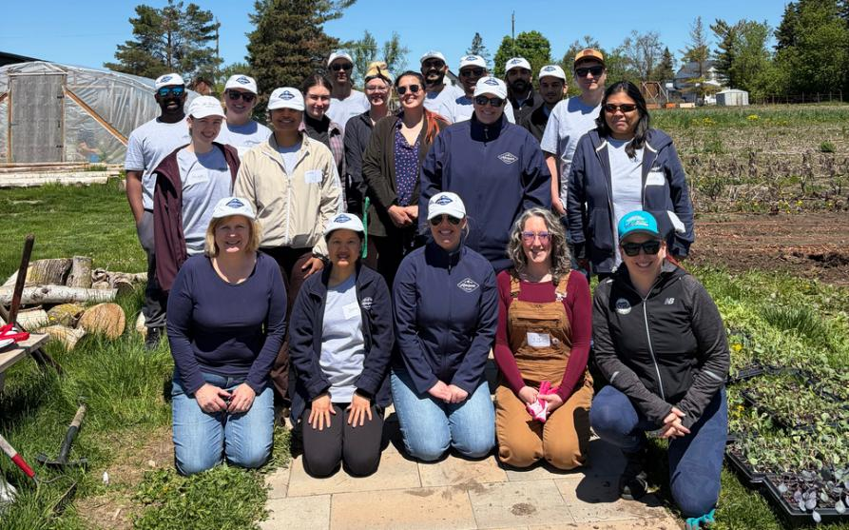
Edwin Binney's Community Farm and Education Centre
Since 2019, Edwin Binney’s Community Farm & Education Centre, UWHKL’s large scale food security project has provided nearly 100,000 pounds of fresh produce to the clients of ten food banks and twenty social service agencies. As food prices continue to rise, there is a corresponding increased need for programs like the farm.
Last year was a year of big changes as our partnership with Fleming College ended with the cancellation of the Sustainable Agriculture program. We chose to see this change as an opportunity and made several new partnerships while strengthening others. We hired our first Farm Manager Raechel Woodrow, who joined us in April. Raechel is a graduate of the Horticulture Technician and Horticulture - Food and Farming programs at Durham College. She brings a fresh perspective, a love for farming and a talent for mentoring the youth working at the farm this season.
This year we were pleased to partner with Ampere for Growing Futures: Sustainable Agriculture and Food Security. This project is funded by an Ontario Trillium Foundation Seed Grant and provides farm internships with a STEAM component provided by Ampere for 6 local youth and enhanced educational opportunities for children and youth, while supporting the day to day work at the farm.
We are always happy to have workplaces join us at the farm. Many hands make light work and it is a great opportunity for team building!

Slide 6
United Way funds vital projects in CKL and Haliburton
  John Howard Society - Nourish Together: Distributed nutritious, pre-made meals to individuals and families in need in Kawartha Lakes, Minden and Haliburton. The project aims to reduce hunger, support community health, and improve quality of life through consistent access to wholesome, ready-to-eat meals.
Local Emergency Needs Fund:
  Big Brothers Big Sisters KLH: A sole caregiver supporting two youth had been without a reliable vehicle for nearly a year due to an unresolved car repair. Living on a limited income, the family could not afford to fix the issue and were left without a functioning vehicle. This funding went directly toward essential repairs to restore their access to transportation.
  The primary caregiver of a family recently lost their job and thus, stable and consistent income. As a result, they struggled to provide food while supporting a child with mental health challenges. These mental challenges also impacted the caregiver’s ability to maintain employment. This funding provided grocery gift cards, helping ensure the family had access to food during this time.
  SIRCH Community Services - Community Meal Program: This program supports individuals experiencing food insecurity and is a vital resource in the community. This funding helped bridge the gap, ensuring meals could continue without interruption and that individuals maintained access to reliable, nutritious food.
Food security support from the farm:
  SIRCH Community Services, EarlyON, BGC Kawarthas, Salvation Army Lindsay, Salvation Army Fenelon Falls, Haliburton Highlands Health Services (Community Services), Community Care CKL, Kawartha Lakes Food Source, Kawartha Lakes Housing Corporation, Centre of Hope
Programs supported in 2025-2026
  VCCS Employment Services - Food for Work program: Provided grocery gift cards for job seekers who are struggling to put food on the table while they look for work.
  Pinnguaq Foundation (Ampere) - Accessible Community Freezer: Purchased a freezer and building materials for a freezer shed to be located at their Makerspace in downtown Lindsay. The freezer will operate 24/7, allowing community members to take what they need and give what they can, without stigma or barriers.
  Kawartha-Haliburton Children’s Foundation - Child Safety Equipment Program: Child Safety Equipment Fund: Provided cribs and safety items to low income families involved with Kawartha-Haliburton Children’s Aid Society who do not have the financial means to purchase these vital child safety items.
  New Canadians Centre - Community Connections Kawartha Lakes: Helped newcomers feel at home in their community through social activities, exploring the region, and learning about local resources. This program helps to foster newcomers’ sense of belonging and community engagement for the benefit of the whole community.
  Central Food Network - Community Volunteer Income Tax Clinic Program: Provided funding support to help address the financial and access barriers faced by residents of Haliburton County who have low & modest incomes and limited resources. Filing income taxes is essential to accessing government benefits and credits and often acts as a gateway to social programs, including subsidized housing, childcare benefits and government health supports.

Slide 7
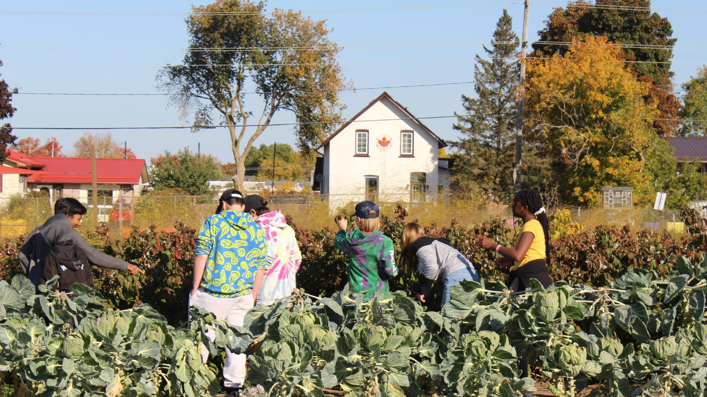
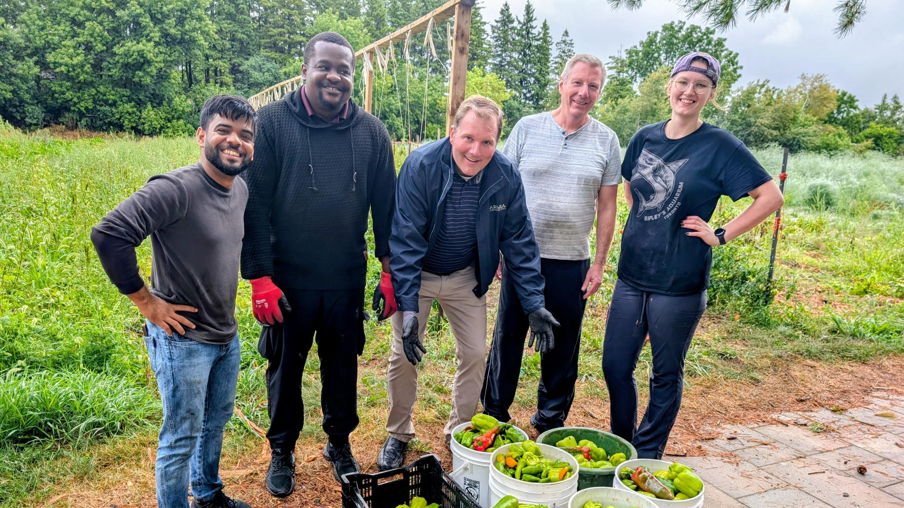
On site workshops, tours and team building opportunities are available at the farm. Come out and volunteer with your colleagues!
"Best field
trip ever!"
2023 CKL Summer Camp participant
Contact our Farm Manager Raechel Woodrow at raechel@hkl.unitedway.ca
for more information.

Slide 8

Leadership Giving:
Your Leadership changes lives. Become a Leadership Donor today!
Leadership donors have the power to be instruments of change. They inspire others and create hope for tomorrow.
With a donation of $1,200 or more, our Leadership level donors are ready to drive change, willing to set a powerful example and become part of the solution to our community’s complex social issues. Local Leaders are passionate about leaving their mark on City of Kawartha Lakes and Haliburton County by creating lasting change.

Slide 9
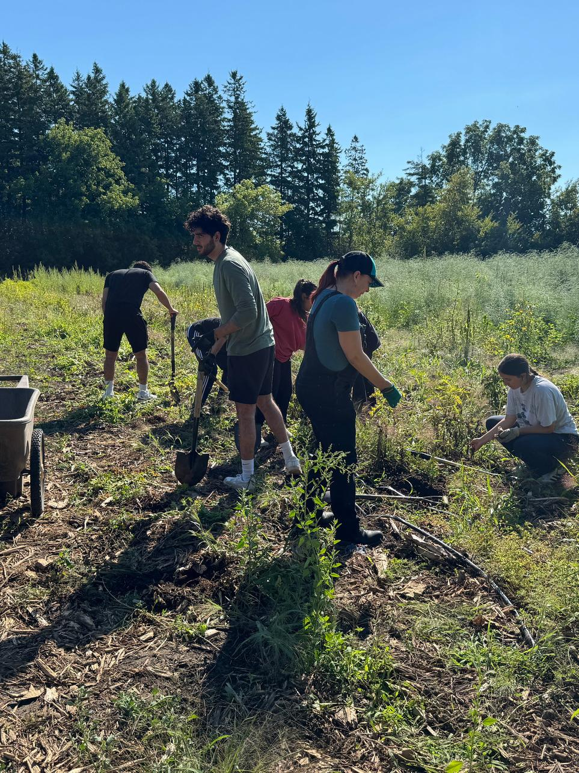
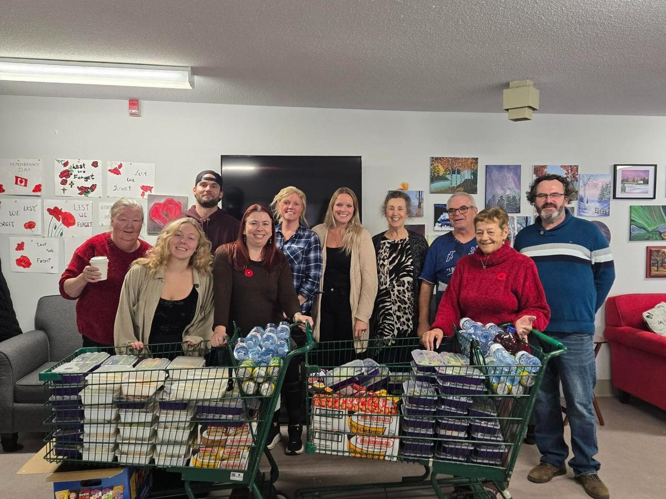
HOW CAN I HELP?

Slide 10
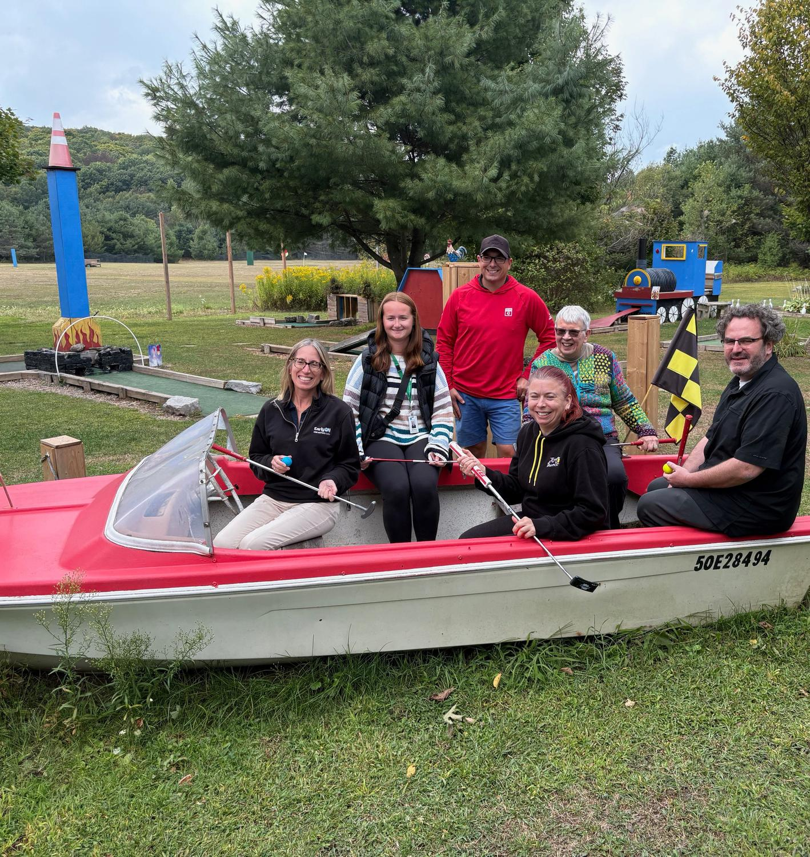
There are many ways to support your United Way!
  Corporations can consider matching public and/or employee donations.
  Donate through payroll deduction at work!
  If you can, become a Leader of the Way donor!
  Make a one-time donation at your workplace!
  Donate online through our website! hkl.unitedway.ca/donate-now/
  Create or participate in special events at work or join us at one of our special events!
  Volunteer at Edwin Binney's Community Farm & Education Centre or a United Way Event!
  Encourage a friend or co-worker to donate to United Way!
  Participate in activities such as Period Promise
  Your business can sponsor a UWHKL event or project (ask us for opportunities and ideas).

Slide 11
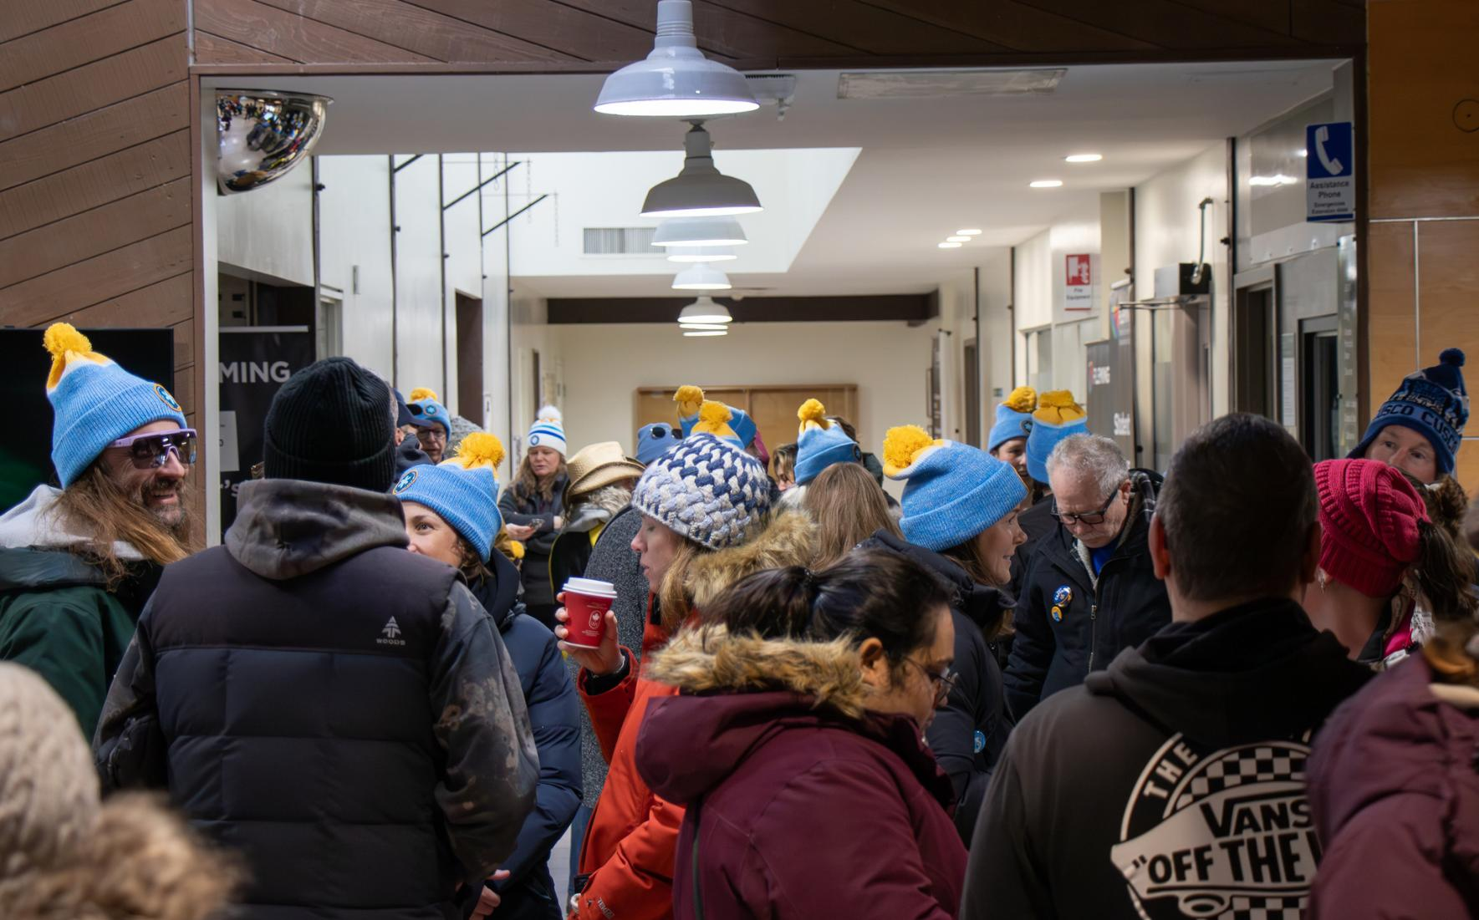
Special event ideas
  Trivia
  Fun run or walk
  Video game sport tournament
  Bingo!
  Get a team together for the Nexicom United Way Funspiel - costumes encouraged!
  Get a staff team together for Coldest Night of the Year.
  And whatever your imagination can come up with. Have fun with your fundraising!

Slide 12

Follow us on Social Media
Facebook: @UWHKL
X: @UnitedWayHKL
Instagram: @unitedwayhkl
YouTube: @UWHKL & @EdwinBinneysCommunityFarm

Slide 13

We’ve moved!
This summer we moved to a new office. You can now find us at 55 Mary Street West, Suite 212. We’re just across the street from our old office in the Gateway Plaza. Our new office is bright, just the right size for us and still close to our food security farm, Edwin Binney’s Community Farm and Education Centre.
We’re excited for this new chapter in our United Way story!

Slide 14
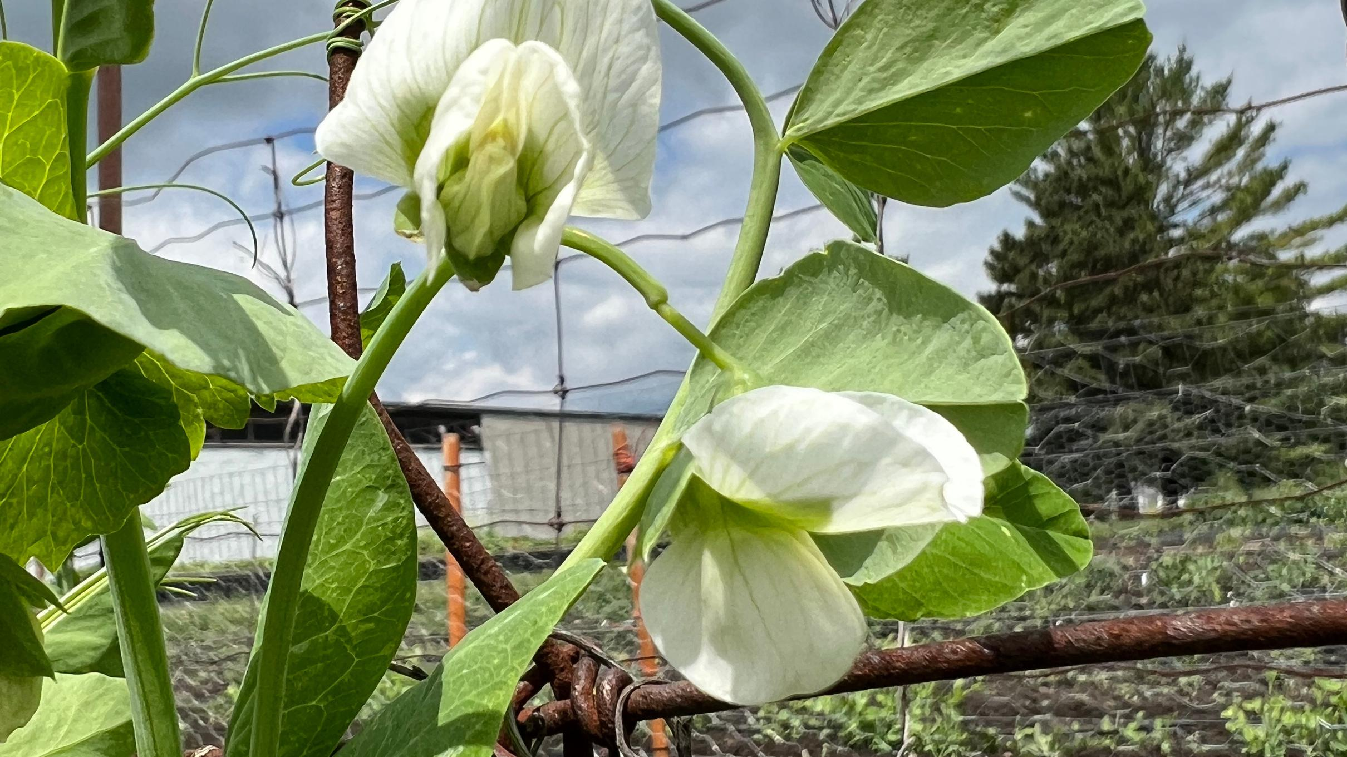
Thank you!
Questions? Contact Shantal Ingram,
Co-Executive Director at shantal@hkl.unitedway.ca
We would be happy to visit your workplace to share more about the work that we do.

